Slide 1
UNIT-II

Slide 2
Macro and Macro processor
Macro:-
Macro instructions are single line abbreviations for group of instructions.
Using a macro, programmer can define a single “instruction” to represent block of code.

Slide 3
MACRO -------- Start of definition
INCR -------- Macro name
A 1,DATA
A 2,DATA ------Sequence of instructions to be
A 3,DATA abbreviated
MEND -------- End of definition

Slide 4
Macro Expansion
Replacement of macro call by corresponding sequence of instructions is called as macro expansion

Slide 5
Source | Expanded source
Macro Incr A 1, data A 2, data A 3, data MEND : : INCR : : INCR : : data DC F’5’ : : END | : : : : : : A 1, Data A 2, Data A 3, Data : : : A 1, Data A 2, Data A 3, Data data DC F ‘5’

Slide 6
Features of macro facility
Macro instructions arguments
:
:
A 1,data1
A 2,data1
A 3,data1
:
:
A 1,data2
A 2,data2
A 3,data2
:
Data1 DC F’5’
Data2 DC F’6’

Slide 7
Source | Expanded Source
MACRO INCR &arg (Macro name with A 1,&arg one argument) A 2,&arg A 3,&arg MEND : : INCR data1 (use of data1 as : operand) : INCR data 2 (use of data2 as : operand) data1 DC F’5’ data2 DC F’6’ : END | : : : : : A 1,data1 A 2,data1 A 3,data1 : A 1,data2 A 2,data2 A 3,data2 : : data1 DC F’5’ data2 DC F’6’

Slide 8
Example: more than one arguments.
A 1,data1
A 2,data2
A 3,data3
:
A 1,data3
A 2,data2
A 3,data1
:
data1 DC F’5’
data2 DC F’6’

Slide 9
Source | Expanded source
MACRO & lab1 INCR & arg 1, & arg 2, & arg 3 & lab 1 A 1, &arg1 A 2, &arg2 A 3, &arg3 MEND : : : LOOP1 INCR data1, data2, data3 : : : LOOP2 INCR data3, data2, data1 : : data1 DC F ‘5’ data2 DC F ‘6’ data3 DC F ‘7’ | : : : : : : : : LOOP 1 A 1, data 1 A 2, data 2 A 3, data 3 : : LOOP 2 A 1, data3 A 2, data2 A 3, data1 : data1 DC F ‘5’ data2 DC F ‘6’ data3 DC F ‘7’

Slide 10
Two ways of specifying arguments to a macro call
A) Positional argument
Argument are matched with dummy arguments according to order in which they appear.
INCR A,B,C
‘A’ replaces first dummy argument
‘B’ replaces second dummy argument
‘C’ replaces third dummy argument

Slide 11
B) keyword arguments
This allows reference to dummy arguments by name as well as by position.
e.g.
INCR &arg1 = A,&arg3 = C, &arg2 =’B’
e.g.
INCR &arg1 = &arg2 = A, &arg2 =’C’

Slide 12
Conditional macro expansion
This allows conditional selection of machine instructions that appear in expansion of macro call.
The macro processor pseudo op-codes AIF and AGO help to do conditional macro expansion.
AIF is conditional branch pseudo op, it performs arithmetic test and branch only if condition is true.
AGO is unconditional pseudo op or it is like go to statement.
Both statements specify a label appearing in some other instruction within macro definition.
These are macro processor directives and they do not appear in expanded source code

Slide 13
Source Program | Expanded Program
: MACRO & arg0 INCR & count, & arg1, & arg 2, & arg3 & arg0 A 1, &arg1 AIF (& Count EQ.1). FINAL A 2,& arg2 AIF (&count EQ 2). FINAL A 3, &arg3 .FINAL MEND : LOOP1 INCR 3, data1, data2, data3 : : LOOP2 INCR 2, data3, data2 : LOOP3 INCR 1, data1 : data1 DC ‘5’ data2 DC ‘6’ data3 DC ‘7’ | LOOP1 A 1, data1 A 2, data2 A 3, data3 : : LOOP2 A 1, data3 A 2, data2 : : LOOP3 A 1, data1 : data1 DC ‘5’ data2 DC ‘6’ data3 DC ‘7’ :

Slide 14
Macro-calls within macro
Macros are abbreviations of instruction sequence. Such abbreviations are also present within other macro definition.

Slide 15
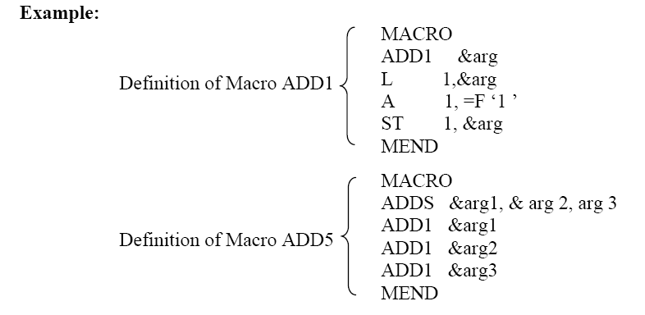
Macro-calls within macro

Slide 16
Source Code | Expanded code (level 1) | Expanded code (level 2)
: : MACRO ADD 1, &arg L 1, &arg A 1, = F ‘10’ ST 1, &arg MEND MACRO ADDS &arg1, &arg2, arg3 ADD1 &arg1 ADD1 &arg2 ADD1 &arg3 MEND : : ADDS data1, data2, data3 : : data 1 DC F‘5’ data 2 DC F‘6’ data 3 DC F‘7’ END | Expansion of ADDS : : ADD1 data 1 ADD1 data 2 ADD1 data 3 : : : : data DC F ‘5’ data DC F ‘6’ data DC F ‘7’ END

Slide 17
Source Code | Expanded code (level 1) | Expanded code (level 2)
: : MACRO ADD 1, &arg L 1, &arg A 1, = F ‘10’ ST 1, &arg MEND MACRO ADDS &arg1, &arg2, arg3 ADD1 &arg1 ADD1 &arg2 ADD1 &arg3 MEND : : ADDS data1, data2, data3 : : data 1 DC F‘5’ data 2 DC F‘6’ data 3 DC F‘7’ END | Expansion of ADDS : : ADD1 data 1 ADD1 data 2 ADD1 data 3 : : : : data DC F ‘5’ data DC F ‘6’ data DC F ‘7’ END | Expansion of ADD1 L 1, data 1 A 1, = F ‘10’ ST 1, data 1 L 1, data 2 A 1, = F ‘10’ ST 1, data 2 L 1, data 3 A 1, = F ‘10’ ST 1, data 3 data1 DC F‘5’ data2 DC F‘6’ data3 DC F‘7’ END

Slide 18
Implementation
There are four basic task that a macro-processor must perform
Recognize macro definition
A macro instruction processor must recognize macro definition identified by MACRO & MEND pseudo – operations.
Save the Definition
The processor must store the macro – definitions which will be needed at the time of expansion of calls.
Recognize the Macro call
The processor must recognize macro calls that appear as operation mnemonics.
Expand calls & substitute arguments
The macro call is replaced by the macro definition. The dummy arguments are replaced by the actual data .

Slide 19
Two pass Macro Processor
General Design Steps
Step 1: Specification of Problem:-
Step 2 Specification of databases:-
Step 3 Specification of database formats
Step 4 : Algorithm

Slide 20
Specify the problem
In Pass-I the macro definitions are searched and stored in the macro definition table and the entry is made in macro name table
In Pass-II the macro calls are identified and the arguments are placed in the appropriate place and the macro calls are replaced by macro definitions.

Slide 21
Specification of databases:-
Pass 1:-
The input macro source program.
The output macro source program to be used by Pass2.
Macro-Definition Table (MDT), to store the body of macro def^{ns}.
Macro-Definition Table Counter (MDTC), to mark next available entry MDT.
Macro- Name Table (MNT), used to store names of macros.
Macro Name Table counter (MNTC), used to indicate the next available entry in MNT.
Argument List Array (ALA), used to substitute index markers for dummy arguments before storing a macro-def^{ns}.

Slide 22
Specification of databases:-
Pass 2:-
The copy of the input from Pass1.
The output expanded source to be given to assembler.
MDT, created by Pass1.
MNT, created by Pass1.
Macro-Definition Table Pointer (MDTP), used to indicate the next line of text to be used during macro-expansion.
Argument List Array (ALA), used to substitute macro-call arguments for the index markers in the stored macro-def^{ns}

Slide 23
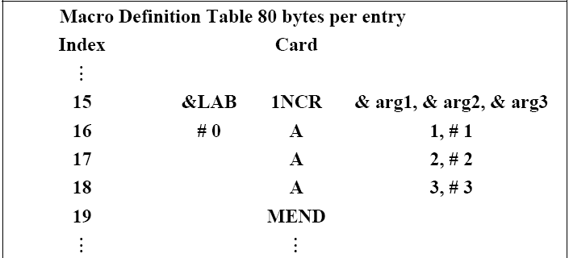
Specification of database format:-

Slide 24
MDT is a table of text lines.
Every line of each macro definition except the MACRO line, is stored in the MDT (MACRO line is useless during macro-expansion)
MEND is kept to indicate the end of the def^{ns}.
The macro-name line is retained to facilitate keyword argument replacement.

Slide 25
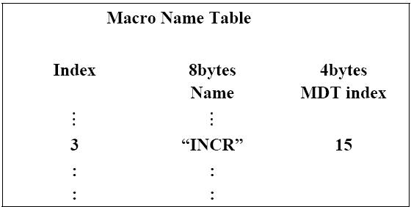
Macro Names Table (MNT):

Slide 26
Each MNT entry consists of
A character string (the macro name) &
A pointer (index) to the entry in MDT that corresponds to the beginning of the macro-definition.(MDT index)

Slide 27
Argument List Array (ALA):
ALA is used during both Pass1 & Pas2 but for some what reverse functions.
During Pass1, in order to simplify later argument replacement during macro expansion, dummy arguments are replaced with positional indicators when def^{n} is stored.
Ex. # 1, # 2, # 3 etc.
The i^{th} dummy argument on the macro-name is represented in the body by #i.
These symbols are used in conjunction with ALA prepared before expansion of a macro-call.
Symbolic dummy argument are retained on macro-name to enable the macro processor to handle argument replacement byname rather by position.

Slide 28
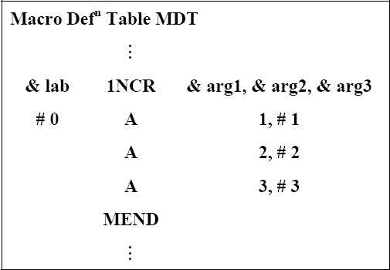
During pass-I

Slide 29
During Pass-II
During Pass2 it is necessary to substitute macro call arguments for the index markers stored in the macro.
Thus upon encountering the call expander would prepare a ALA as shown below:
LOOP 1NCR DATA1, DATA2, DATA3,}
→ Call in main prog.
→ ALA is prepare of after this call is encountered.

Slide 30
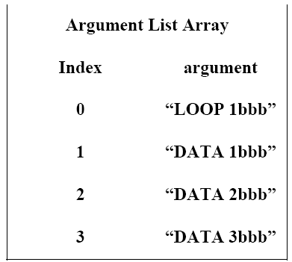

Slide 31
Algorithm
Pass1 of macro processor makes a line-by-line scan over its input.
Set MDTC = 1 as well as MNTC = 1.
Read next line from input program.
If it is a MACRO pseudo-op, the entire macro definition except this (MACRO) line is stored in MDT.
The name is entered into Macro Name Table along with a pointer to the first location of MDT entry of the definition.
When the END pseudo-op is encountered all the macro-def^{ns} have been processed, so control is transferred to pass2

Slide 32
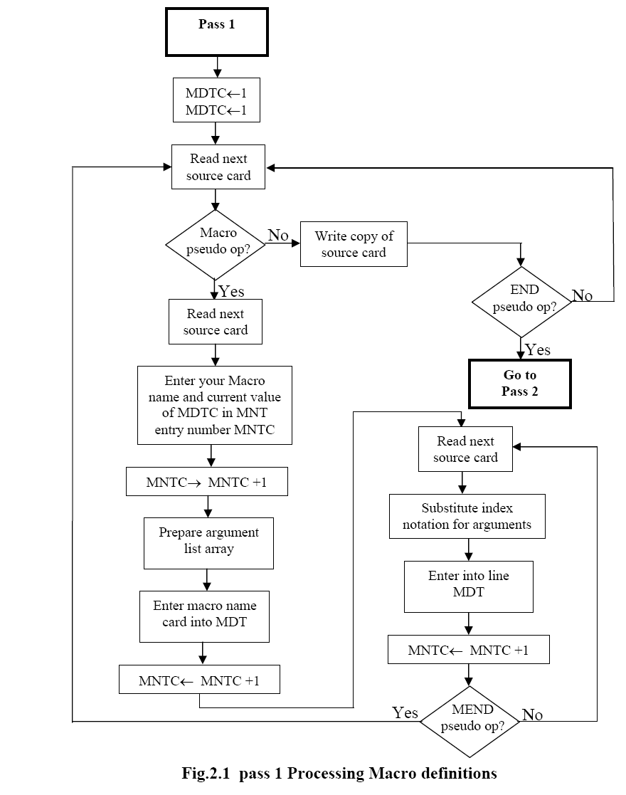
MDTC← 1
MNTC← 1
Enter Macro Name and Current value of MDTC in MNT
MDTC← MDTC+1
MDTC← MDTC+1

Slide 33
Algorithm for Pass – 2
This algorithm reads one line of i/p prog. at a time.
for each Line it checks if op-code of that line matches any of the MNT entry.
When match is found (i.e. when call is pointer called MDTF to corresponding macro def^{ns} stored in MDT.
The initial value of MDTP is obtained from MDT index field of MNT entry.
The macro expander prepares the ALA consisting of a table of dummy argument indices & corresponding arguments to the call.
Reading proceeds from the MDT, as each successive line is read, The values form the argument list one substituted for dummy arguments indices in the macro def^{n}.
Reading MEND line in MDT terminates expansion of macro & scanning continues from the input file.
When END pseudo-op encountered , the expanded source program is given to the assembler

Slide 34
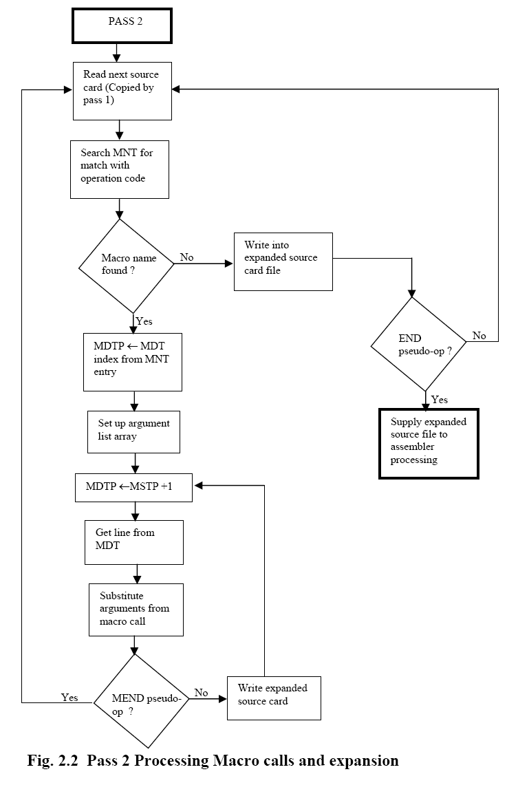
MDTP ← MDTP + 1

Slide 35
MACROS |  | PROCEDURE
1 | The corresponding machine code is written every time a macro is called in a program. | 1 | The Corresponding m/c code is written only once in memory
2 | Program takes up more memory space. | 2 | Program takes up comparatively less memory space.
3 | No transfer of program counter. | 3 | Transferring of program counter is required.
4 | No overhead of using stack for transferring control. | 4 | Overhead of using stack for transferring control.
5 | Execution is fast | 5 | Execution is comparatively slow.
6 | Assembly time is more. | 6 | Assembly time is comparatively less.
7 | More advantageous to the programs when repeated group of instruction is too short. | 7 | More advantageous to the programs when repeated group of instructions is quite large.

